Slide 1
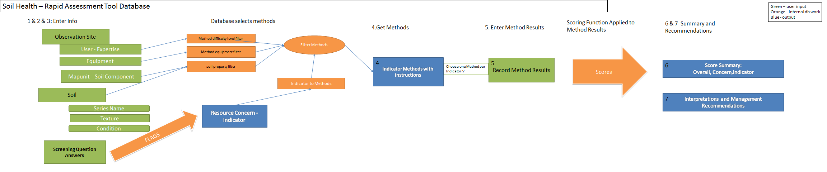
SH-RAT: Operational Schematic

Slide 2
Soil Health – Rapid Assessment Tool

Slide 3
SH - RAT
A tool to guide soil health assessment
Interactively guides the user through assessments that are:
  Rapid and qualitative
  Relatively easy
  Field based
Should be tablet or mobile device based

Slide 4
Overview
User Enters Site, Soil, and User Information
User Answers Questions that relate to Resource Concerns
Tool Uses Inputs to Select Appropriate SH indicators and methods
User Enters Results from SH indicator methods
Tool Scores Results and Provides Metrics of SH
Tool Provides Recommendations for Improving SH

Slide 5
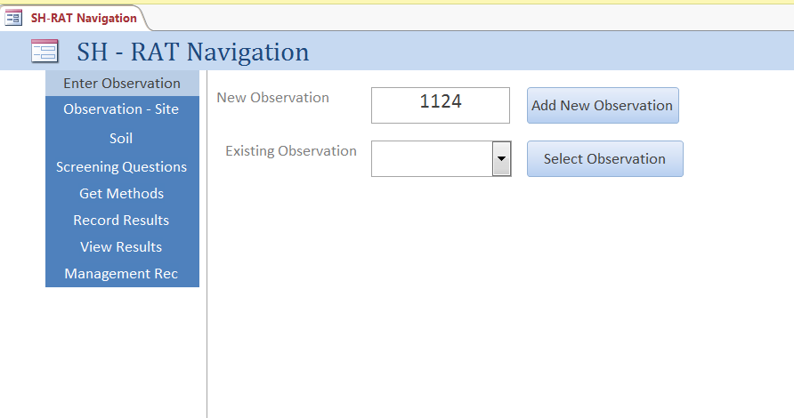
Begin SH-RAT
Access Database Navigation

Slide 6
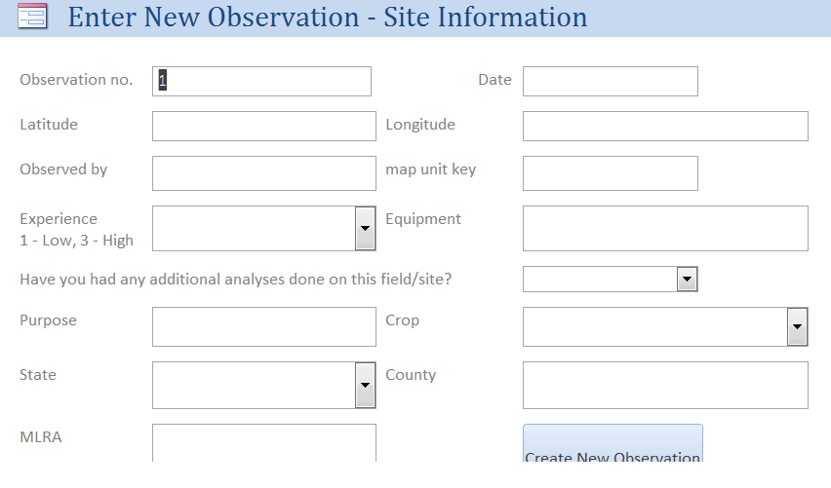
Enter Site and Observation Info
Unique ID
Date
Location Info
  State, County
  MLRA
  Climate
User Info
Goal
Target Crop
  (for determining optimum conditions)

Slide 7
Soil Information
Surface Info
  Texture by feel (instructions will guide user through simple procedure)
  Clay estimate (tool gives range of possible values)
  % rock Fragments (general class
Condition: moist, wet, dry
Soil Series Names
  (could potentially interact with GPS and guide user through selection)

Slide 8
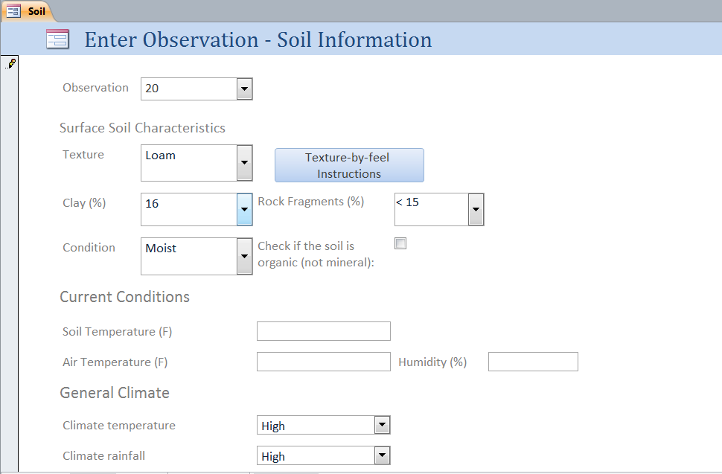
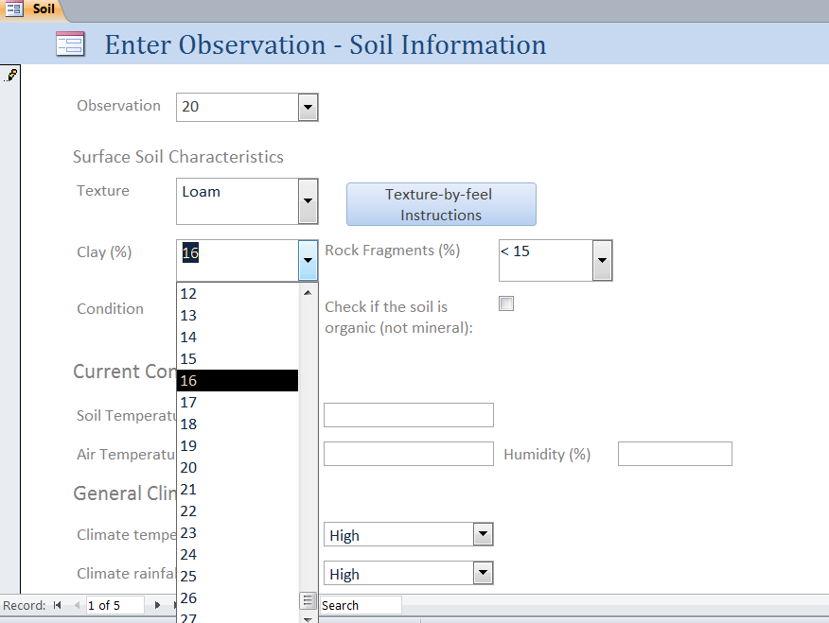

Slide 9
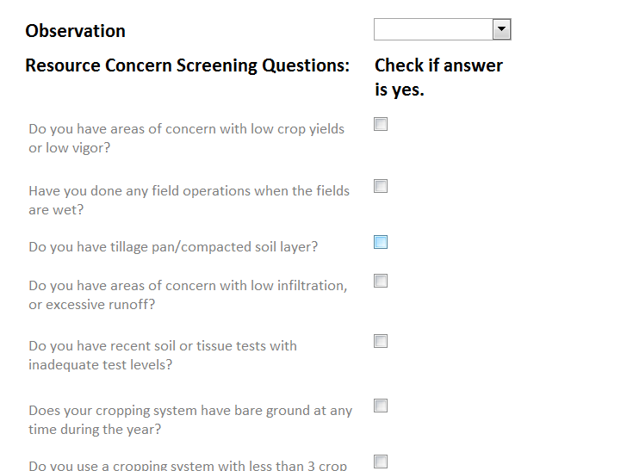
Resource Concern - Screening

Slide 10
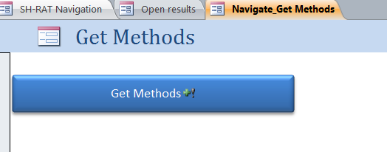
SH-RAT
Database performs queries with provided information
Creates tables and forms to record and store method results

Slide 11
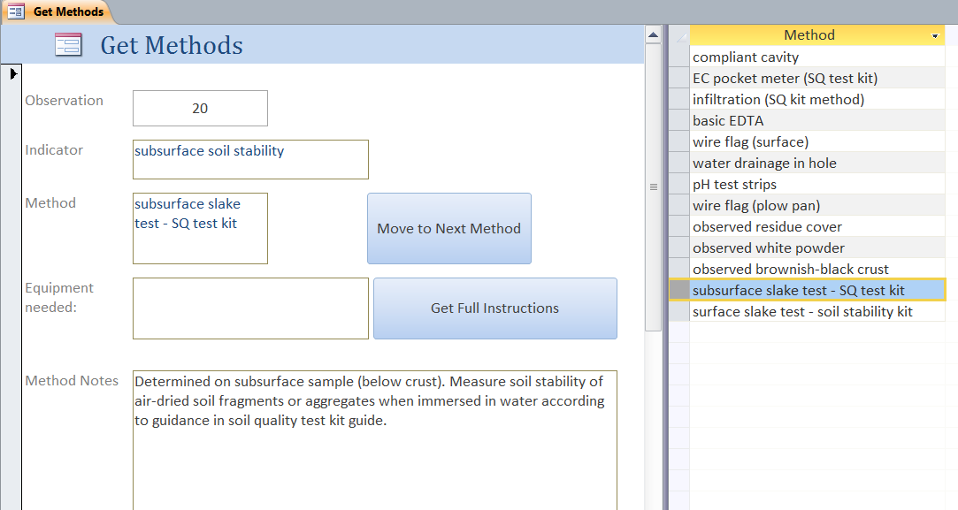
SH-RAT: Interactive Method Info

Slide 12
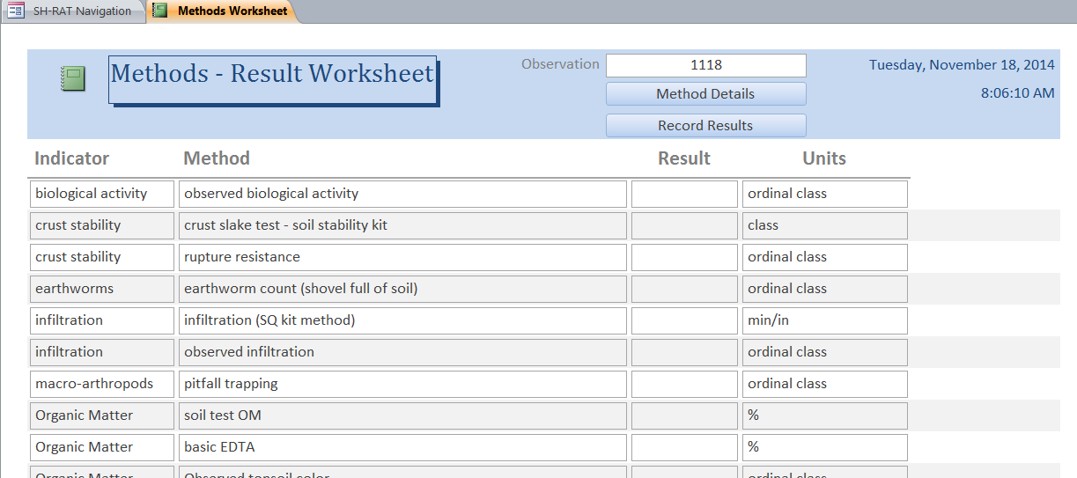
SH-RAT: report that could be printed to record results

Slide 13
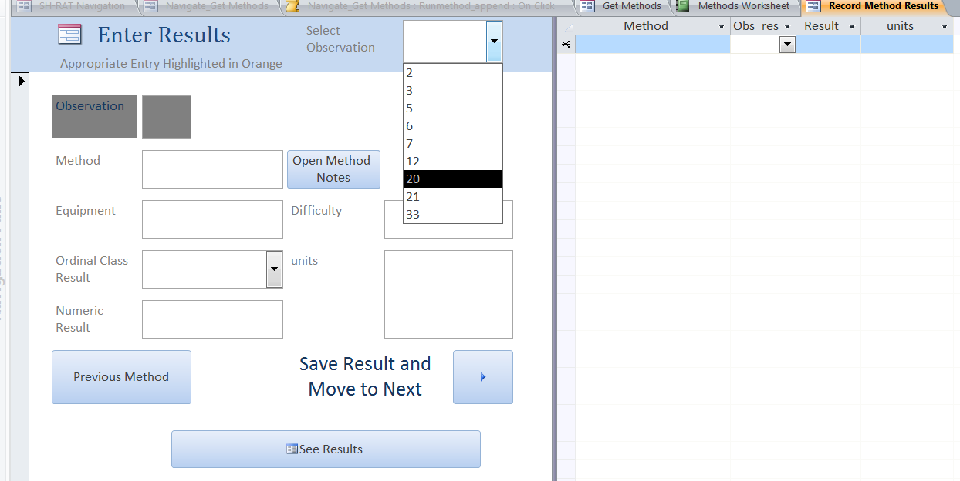
Interactive Worksheet to Enter Results

Slide 14
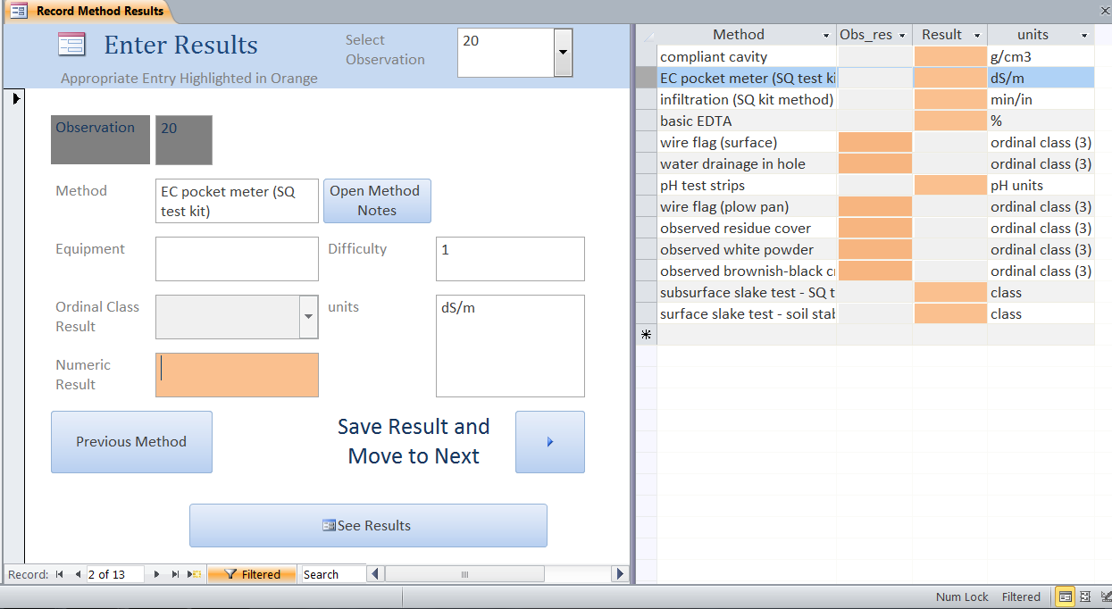
Form Guides you through appropriate method results (observations vs. numeric values)

Slide 15
SH-RAT: Results
Presented by Indicator
  SH score from 0 -1
Presented by Resource Concern
  SH score form 0 – 1
  Recommendations for low scores
FUTURE WORK: Further comparisons across observations or over time.

Slide 16
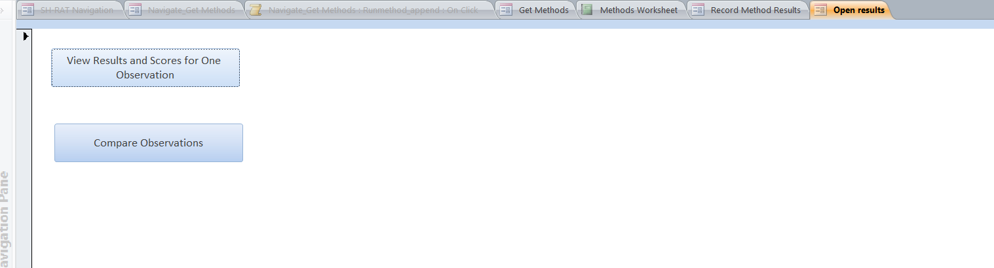
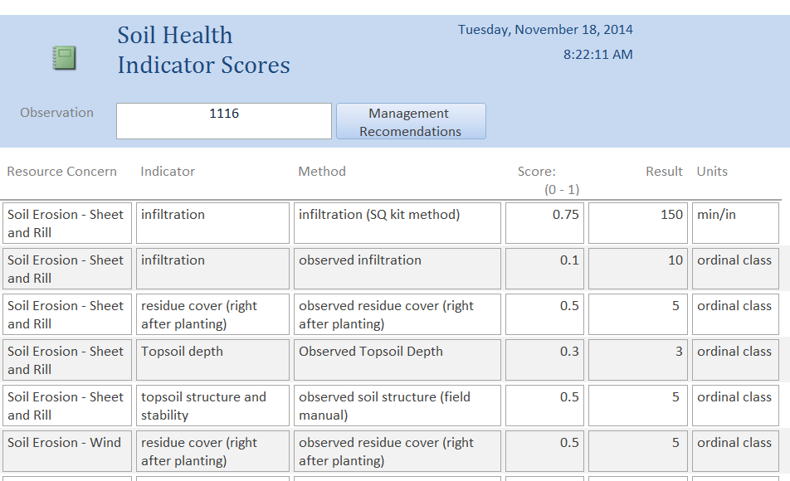
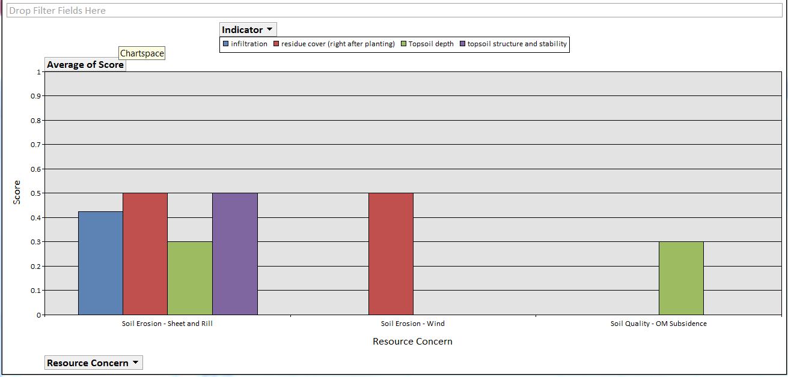

Slide 17
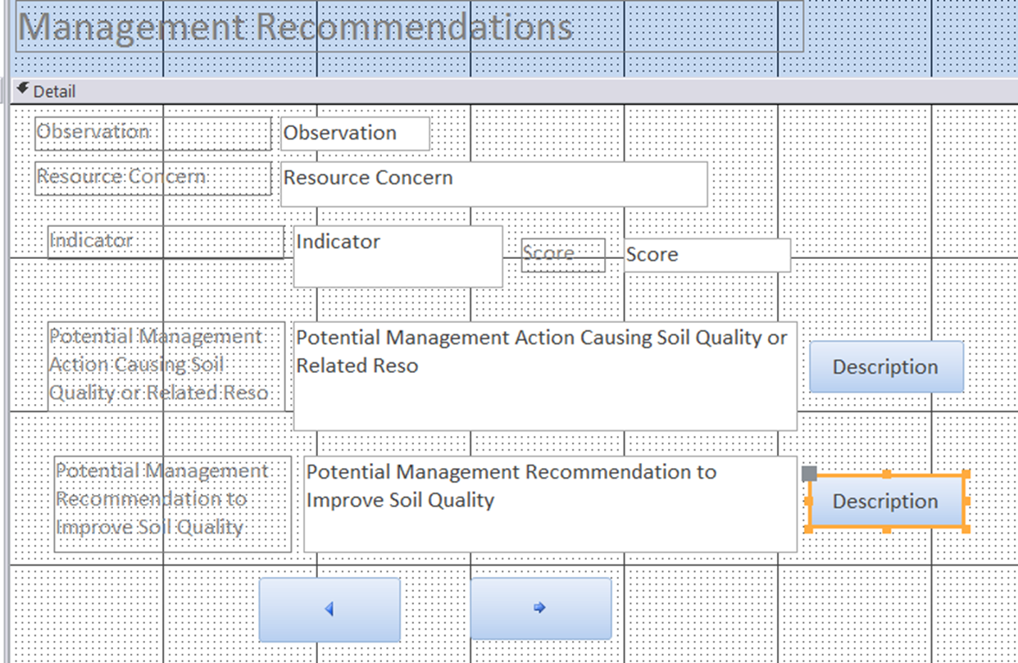
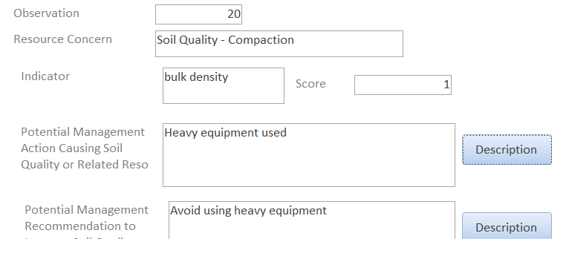
SH - Recommendations
Notes:
Provide information about management recommendations for each indicator/resource concern: Possible causes and possible management actions

Slide 18
SH Indicator - Interpretation
  Basic information about each indicator and it’s effect on soil function
  Relative function for ranges of indicator result and score
    How does a high scoring soil function?
    How does a low scoring soil function?
    How is this soil likely to function?

Slide 19
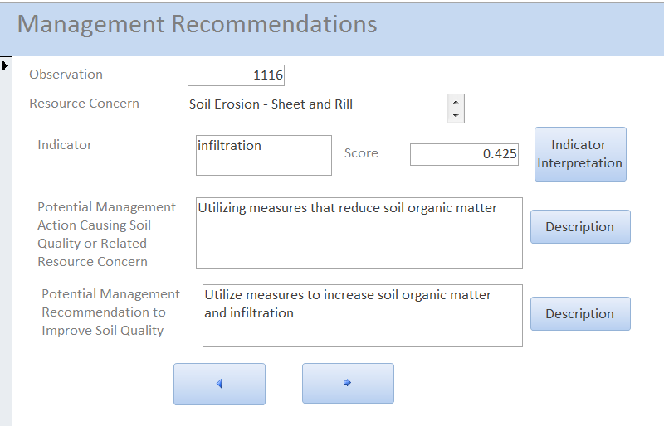
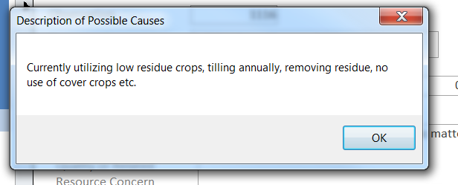
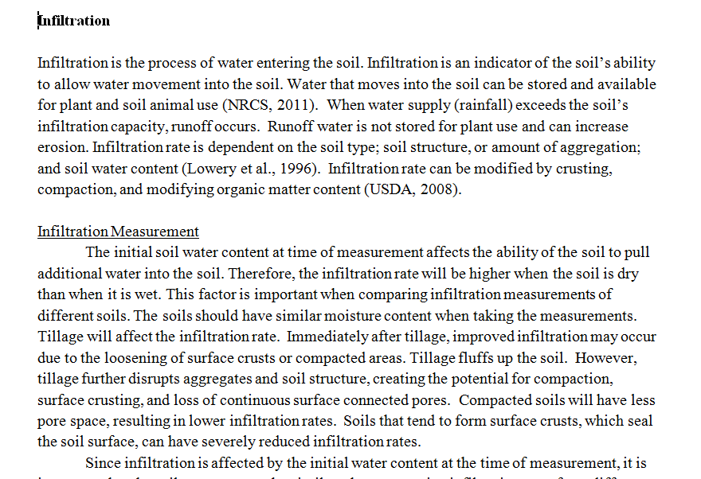

Slide 20
Additional Functionality Needed
Interact with GPS and GIS to guide user in soil map unit and possibly soil series selection
Navigate between current session and instructions/information
Maintain data integrity (one observation) throughout session
Improve storage, retrieval and integration of SH information

Slide 21
SH-RAT: Operational Schematic

